Slide 1
Detail Project Report BIG GAME CENSUS DATA VISUALIZATION PROJECT
-shivanireddy

Slide 2
Introduction The recently released Big Game Census data visualization @(https://www.census.gov/library/visualizations/interactive/big-game-census.html) includes player data (from Yahoo Sports: https://sports.yahoo.com/nfl/teams/ ) and U.S. Census Bureau Population Estimates data for incorporated places and states, vintage 2016 and 2017, respectively. This Big Game Census data visualization takes a fun look at where Super Bowl 52 players come from, the related population figures, and opens up pathways (via embedded links) to additional census data points.The Big Game Census looks at Super Bowl players and their birthplaces, and gives you access to related population data. Did you know that this game also features players from 32 different states, one island territory, and three countries? The Big Game Census interactive visualization takes a closer look at the players’ hometowns, and gives you access to Census data points for those places. If you have not decided which team you are pulling for this Sunday, maybe you’ll find a connection to your state or your hometown that will help you decide.

Slide 3
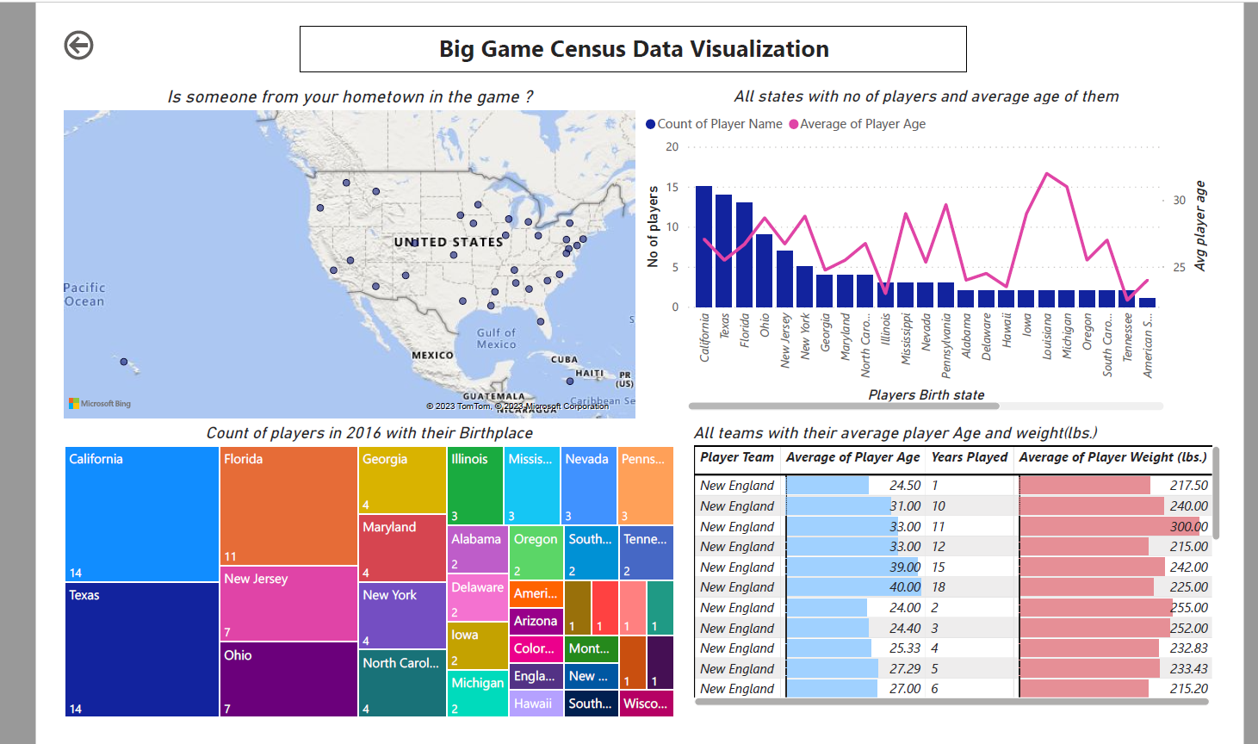

Slide 4
Insights drawn from the visualization Big Game Census Data allows us to draw insights about the players, teams, states with most players, average age of players, average years played, median weight, player birthplace, player colleges, top performing players. These insights are of great interest for game enthusiasts, team supporters, fans of the players, etc. Big Game Census data visualization project utilizes three separate excel data files which are used simultaneously to extract relevant information and portray the same. The visualization shows the following details: (i) Is someone from your hometown in the game? (ii) All States with Number of Players, Players Teams & Average Player Age (iii) All Teams with their Avg. Player Age, Avg. Years Played, Median Player Weight & Conference (iv) Player Birthplace with its 2016 Population Estimates

Slide 5




Tools used Business Intelligence tools used in this project are :

Slide 6
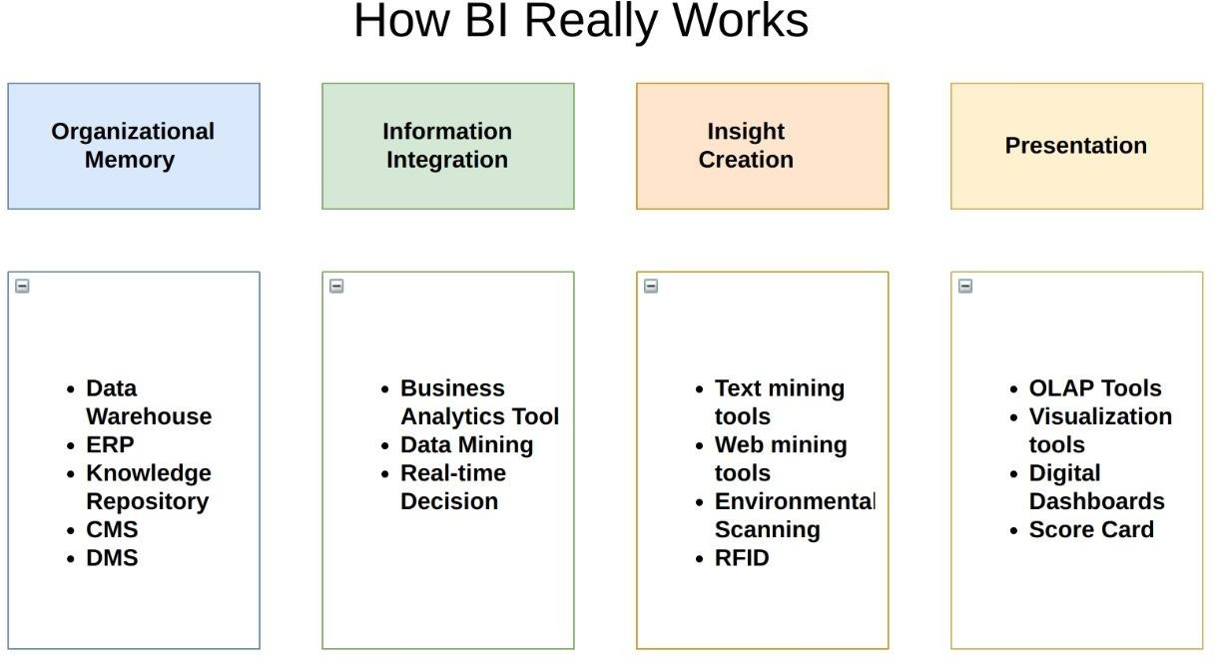

Slide 7
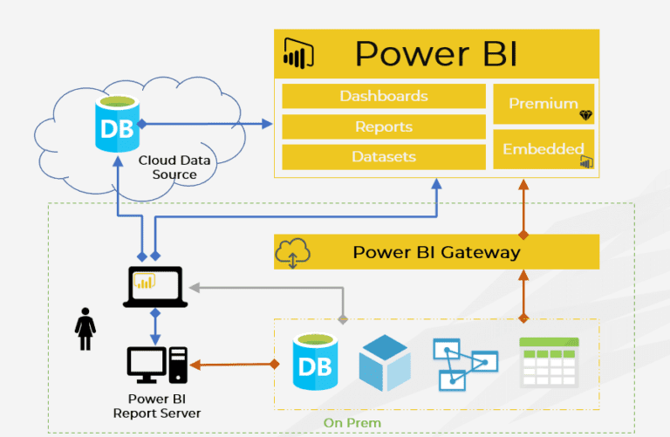
Power bi Architecture Diagram

Slide 8
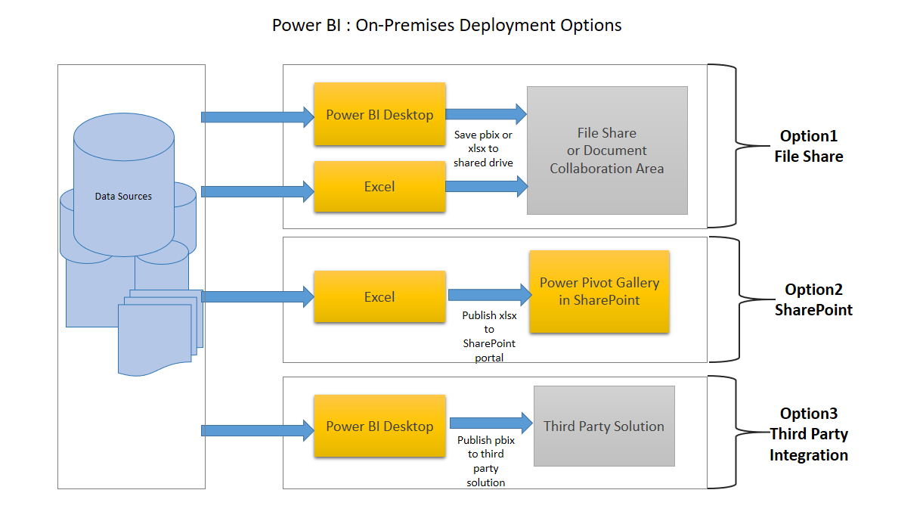
Deployment in power bi

Slide 9
Unit Test Cases
TEST CASE DESCRIPTION | EXPECTED RESULTS
Is someone from your hometown in the game? | When hovered over the map, one can see the number of players from a particular state along with the team to which they belong.
Average Player Age vs Player Birth State | When hovered over the visualization, all States with number of players, player teams & average player age is shown.
All teams information | A table is used to here which displays the player teams, avg. player age, avg. years played, median player weight and conference to which the players belong
Player birthplace with population estimates | A treemap shows all the birthplaces having big population estimates with big and dark coloured squares and states having small population estimates are shown with small and light coloured squares.

Slide 10
THANK YOU

